Slide 1
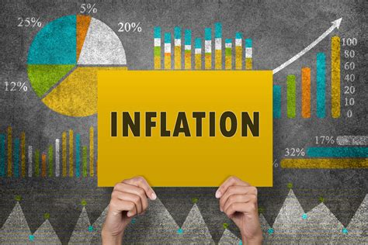

Slide 2

QUICK HISTORY LESSON…
Before governments issued ‘reserve notes’ (AKA modern money, cash, coins, ect.)
Metals like gold & silver were commonly used as the medium of exchange between goods and services

Slide 3
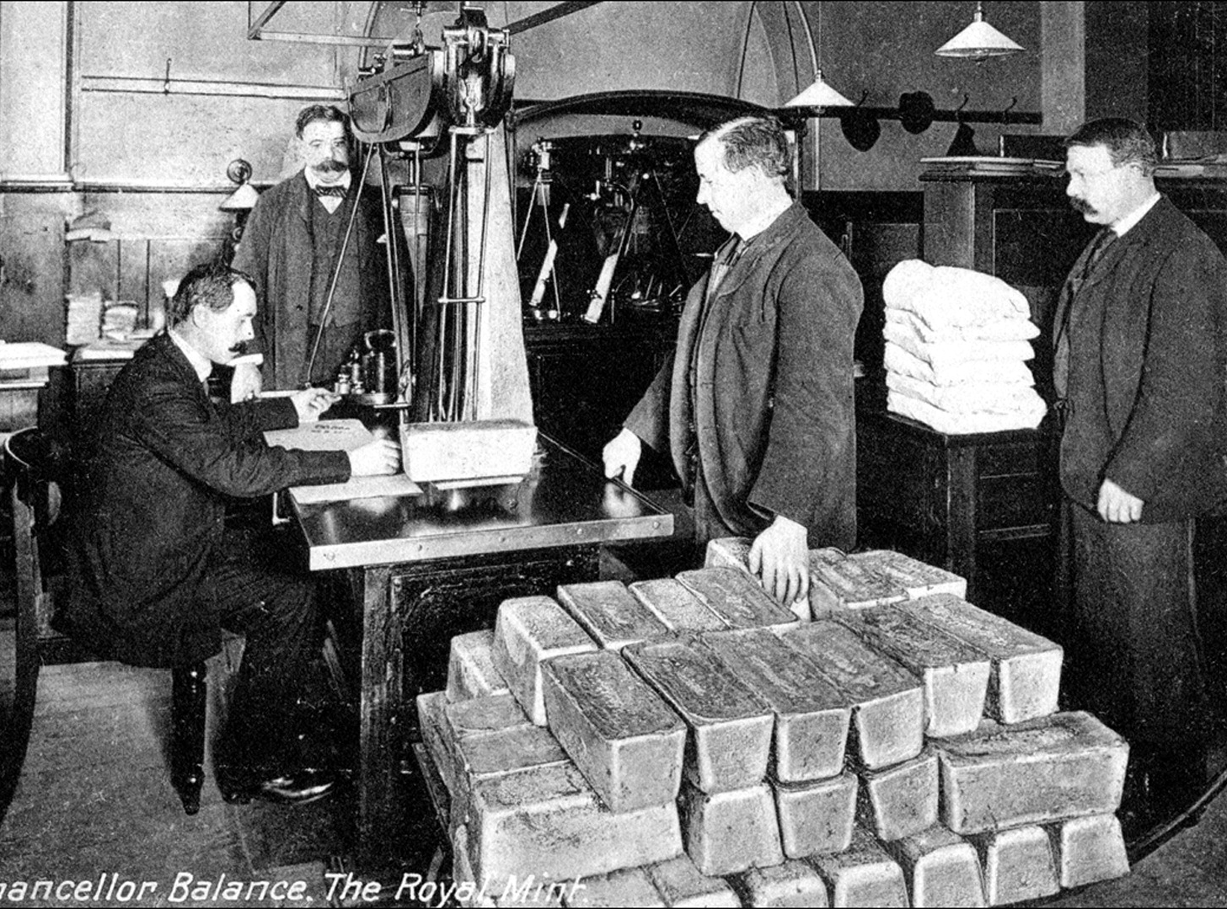

Slide 4
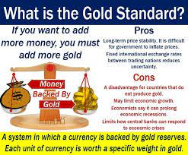

Slide 5
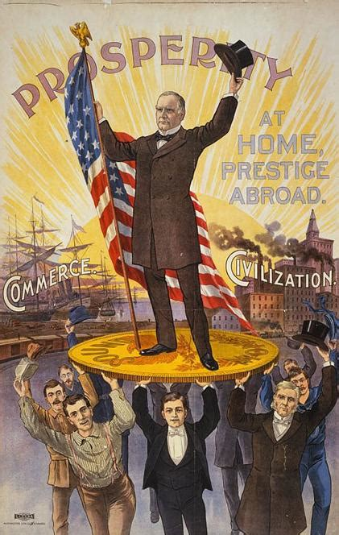
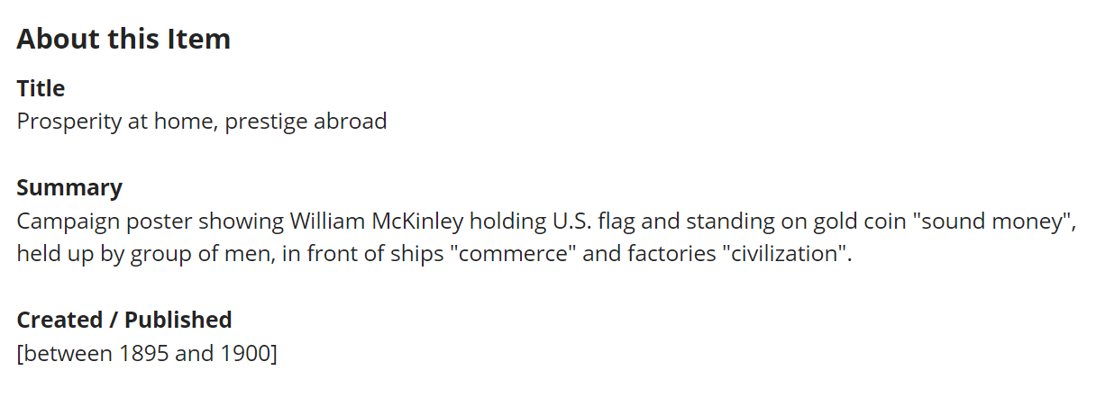
“sound money”

Slide 6
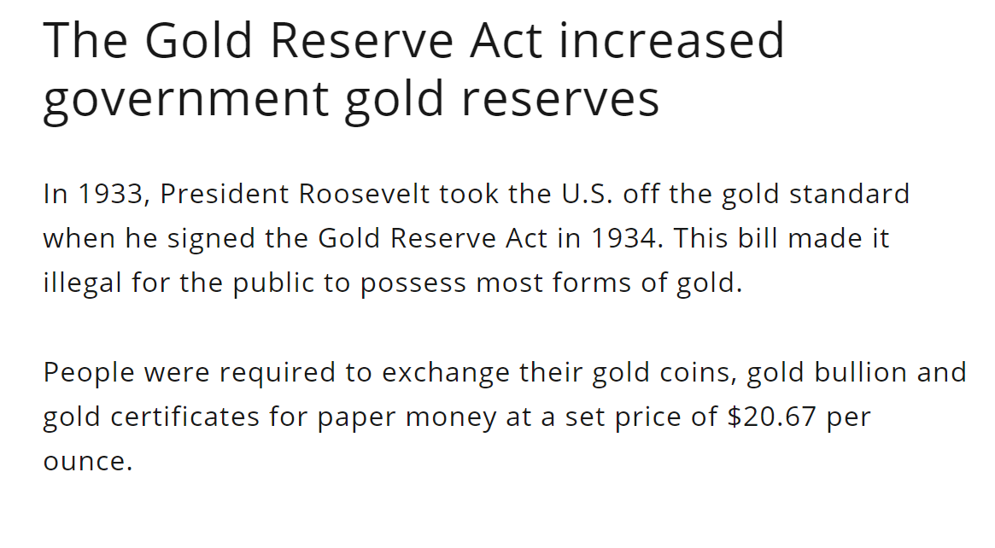
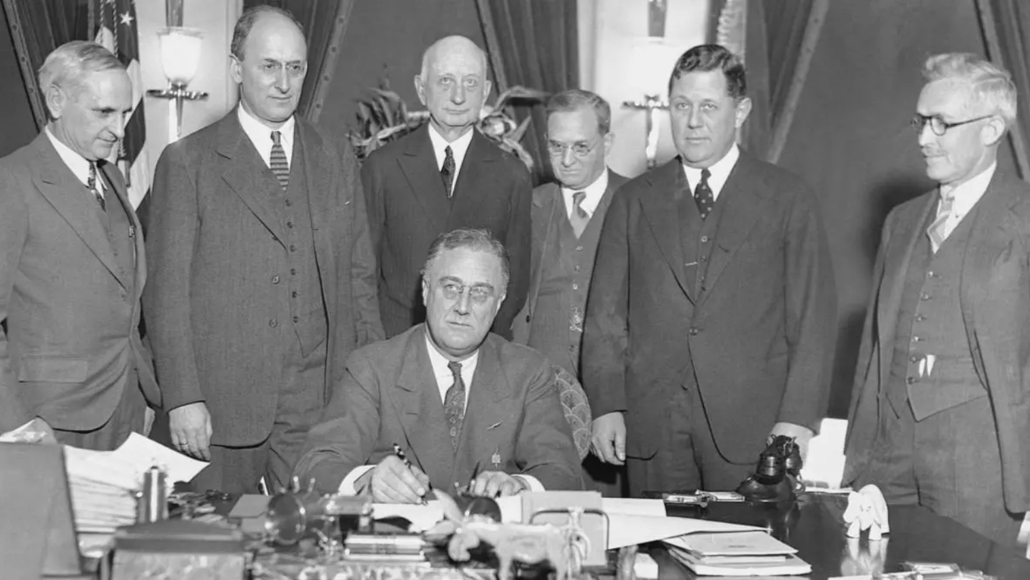

Slide 7
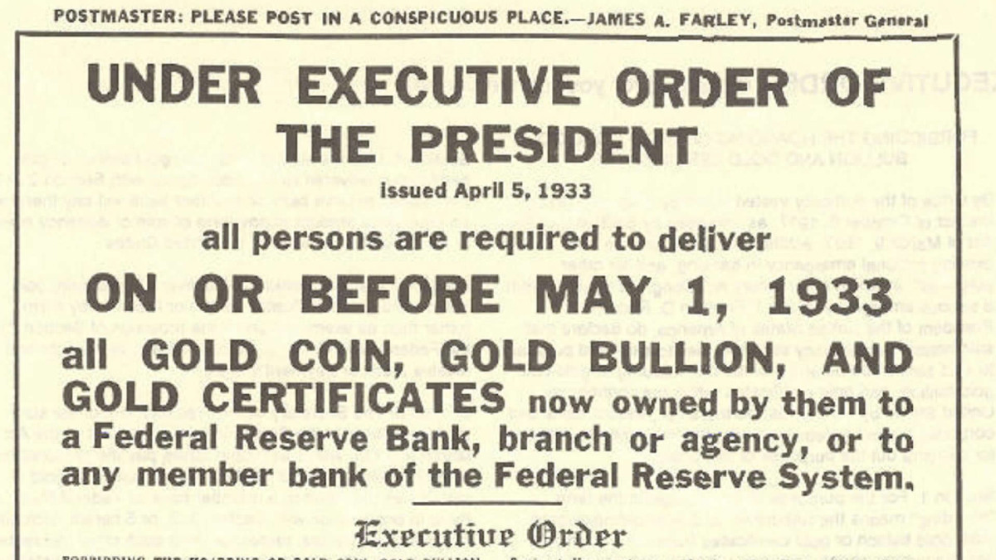

Slide 8





Then in 1971, Nixon took the US dollar FULLY off the gold standard
Terminating convertibility of the US dollar to physical GOLD
Effectively, ruining the party…

Slide 9
Unfortunately, we all know what happened next…

Slide 10
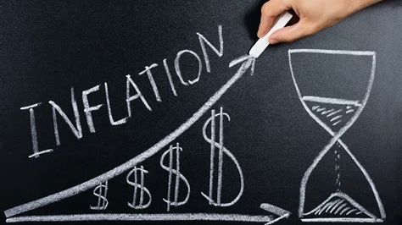

Slide 11
When inflation goes up…

Slide 12
Purchasing power goes down…

Slide 13
The US Dollar has lost 96% of it’s purchasing power since it’s inception

Slide 14
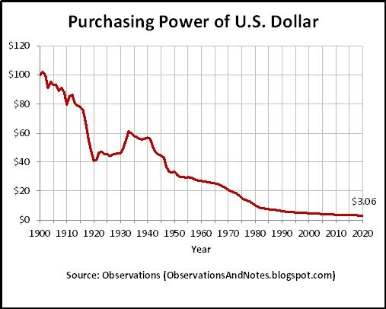

Slide 15

This forces the cost of goods to go up

Slide 16
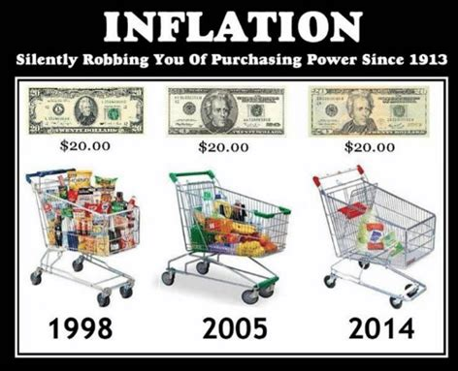

Slide 17

This makes people spend less money

Slide 18
Which makes the velocity of money go down

Slide 19
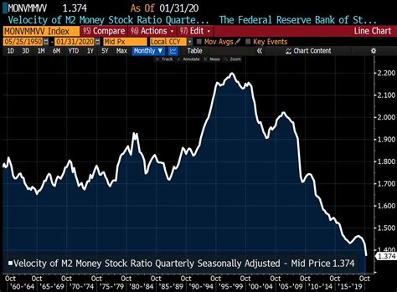

Slide 20
So what’s the solution?

Slide 21
Some would tell you to buy precious metals

Slide 22
Some would tell you to buy Bitcoin…

Slide 23
But neither of those are immediate solutions…

Slide 24
How do we address inflation TODAY?

Slide 25



Slide 26
INFLATION COIN
“INFCoin”

Slide 27
So what’s the best indicator for inflation today?

Slide 28


Slide 29
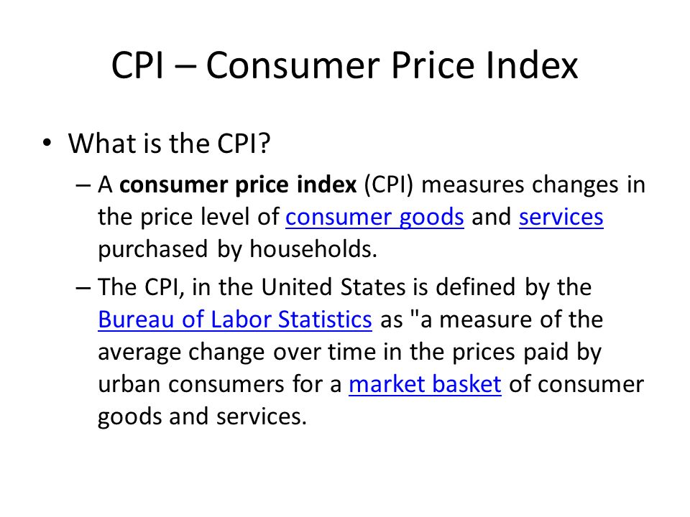

Slide 30
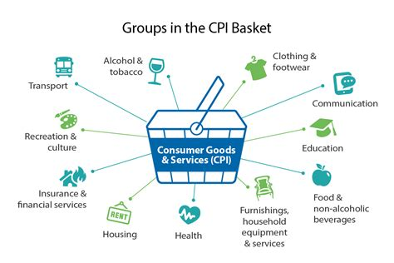

Slide 31
INFCoin measures the CPI monthly
And adjusts the amount of tokens each
wallet is holding.

Slide 32
So when inflation spikes…

Slide 33
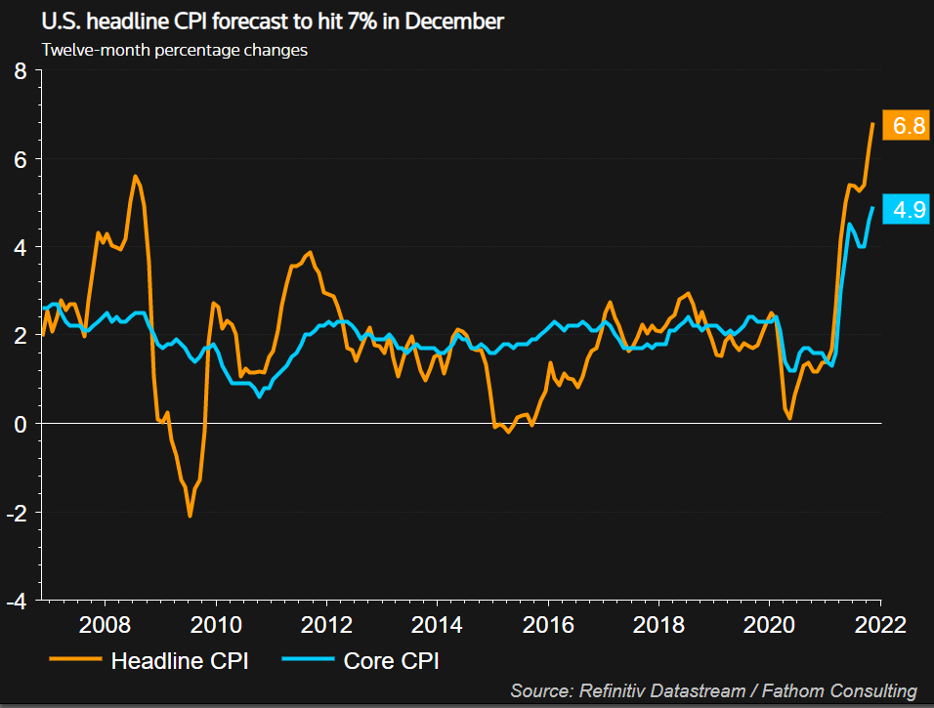

Slide 34
So does your balance!

Slide 35


Slide 36


Slide 37


